Slide 1

AZURE KINECT DK
Project AzureKinectDK using Open3D for visualize
YOO SUNG MIN
NAME

Slide 2
Chapter 1
개요
소요 시간 The time required
Python Development
40%
Build C++ using CMake
60%
0 | 10 | 20 | 30 | 40 | 50 | 60 | 70 | 80 | 90
개발 개요
- 파이썬 Open3D를 이용한 AzureKinect 개발
- Open3D C++ API를 사용하기 위한 Build & Install

Slide 3
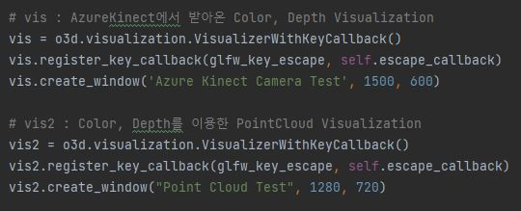

Chapter 2
Python Dev.
파이썬 Open3D 개발 Development using Open3D Python API
Real time PointCloud Streaming
문제점의 핵심

Slide 4
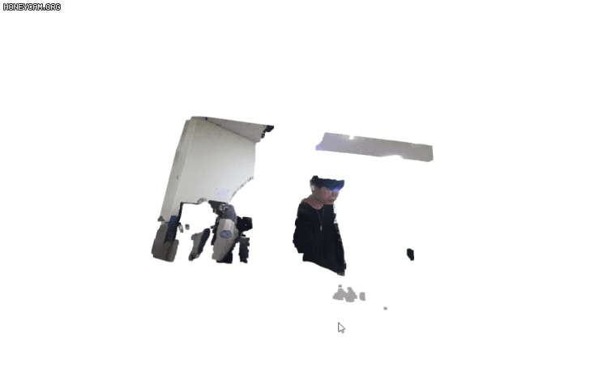
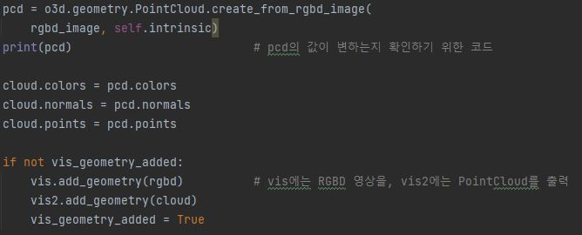
Chapter 2
Python Dev.
파이썬 Open3D 개발 Development using Open3D Python API
Real time PointCloud Streaming
Output Screen (vis2)

Slide 5
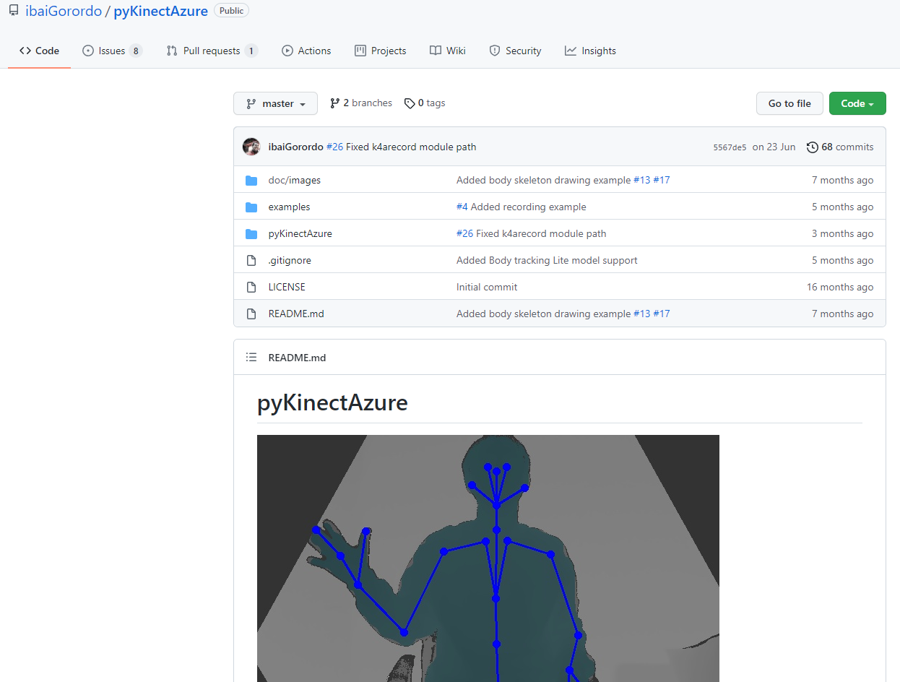
Chapter 2
Python Dev.
파이썬 Open3D 개발 Development using Open3D Python API
PyKinectAzure (Wrapping Module)
https://github.com/ibaiGorordo/pyKinectAzure

Slide 6
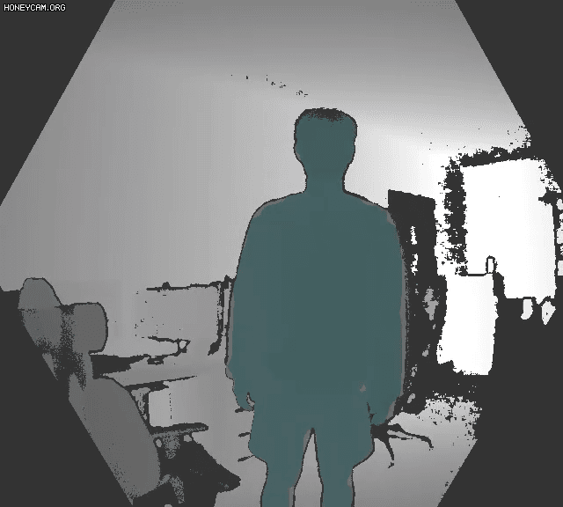
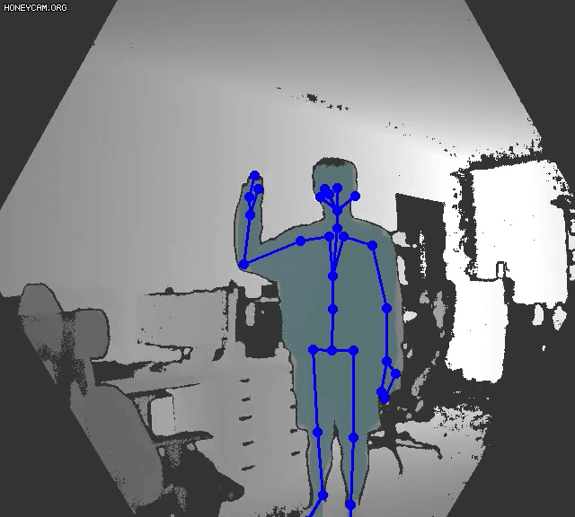
Chapter 2
Python Dev.
파이썬 Open3D 개발 Development using Open3D Python API
PyKinectAzure (Wrapping Module)
Body Segmentation
Body Segmentation & Skeleton Traking

Slide 7
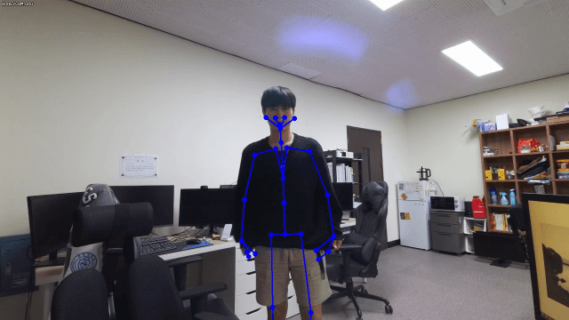
Chapter 2
Python Dev.
파이썬 Open3D 개발 Development using Open3D Python API
PyKinectAzure (Wrapping Module)
Body Tracking with RGB Color Camera

Slide 8




Chapter 2
Python Dev.

Slide 9
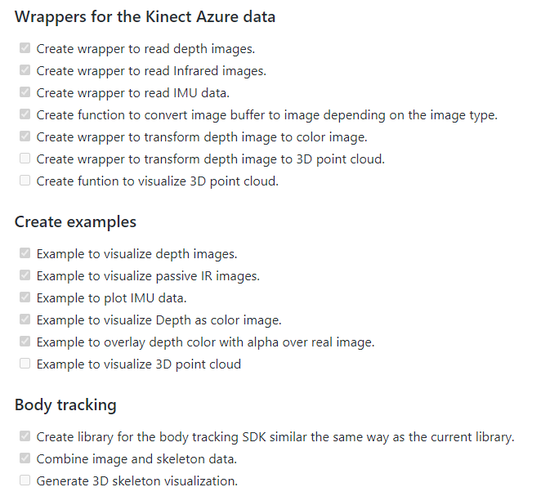
Chapter 3
Tipping Point
변경에 대한 이유 The reason why I decide to change
PyKinectAzure (Wrapping Module)
-
PyKinectAzure의 Github Readme.md 중 발췌
https://github.com/ibaiGorordo/pyKinectAzure

Slide 10


Chapter 4
C++ API
Open3D C++ API Bulid Using CMake & MSVS 2019
CMake : 멀티 플랫폼을 위한 빌드 지원 시스템

Slide 11

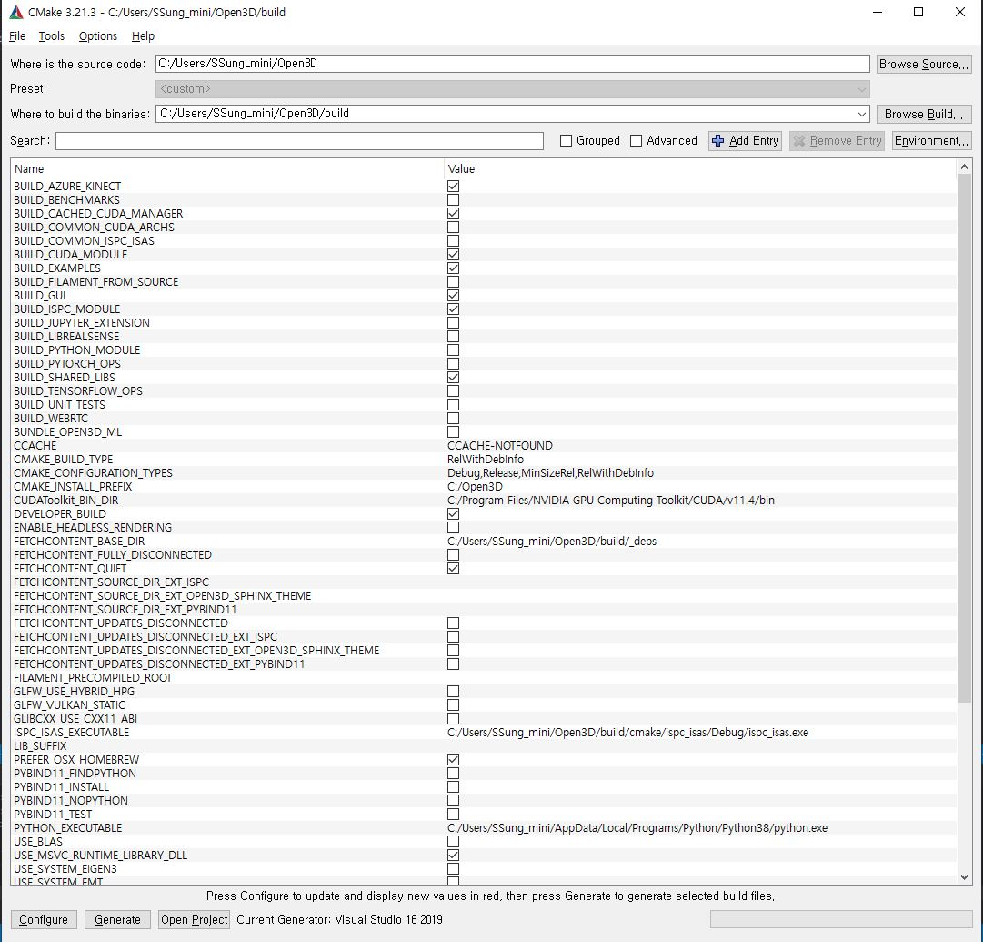
Chapter 4
C++ API
Open3D C++ API Bulid Using Cmake & MSVS 2019
-

Slide 12

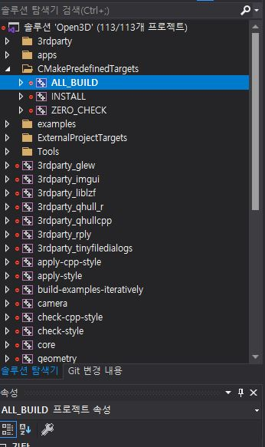
Chapter 4
C++ API
Open3D C++ API Bulid Using Cmake & MSVS 2019
-

Slide 13


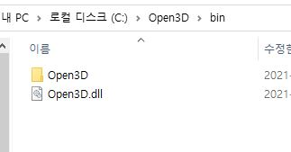
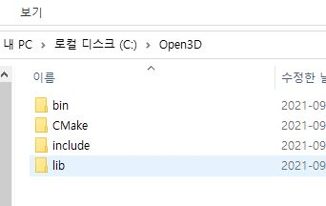
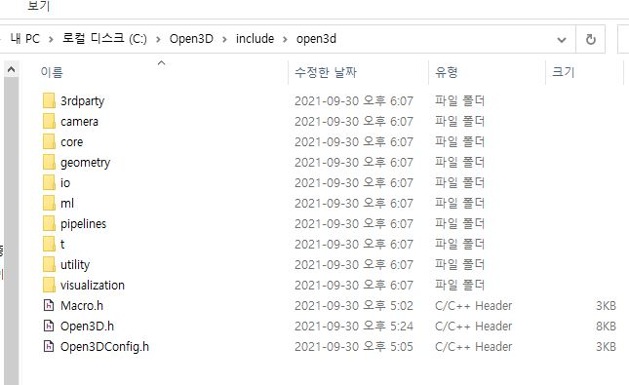
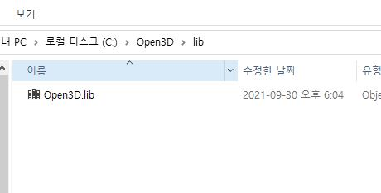
Chapter 4
C++ API
Open3D C++ API Bulid Using Cmake & MSVS 2019

Slide 14
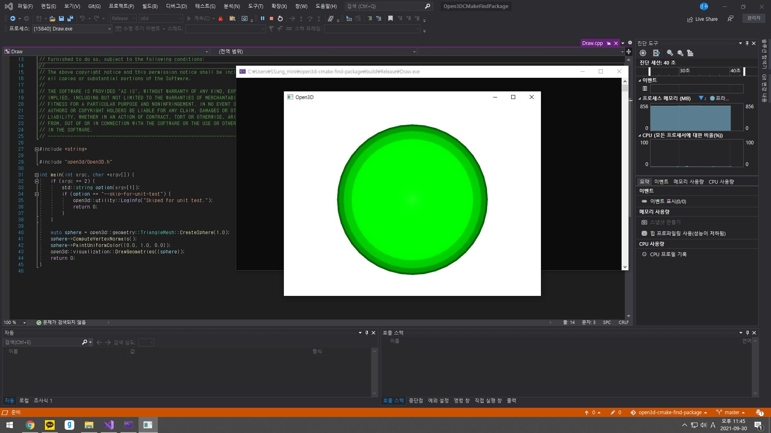
Chapter 4
C++ API
Open3D C++ API Bulid Using Cmake & MSVS 2019
-
Find Pre-Installed Open3D Package in Cmake
Test Code : Draw.cpp
https://github.com/isl-org/open3d-cmake-find-package

Slide 15
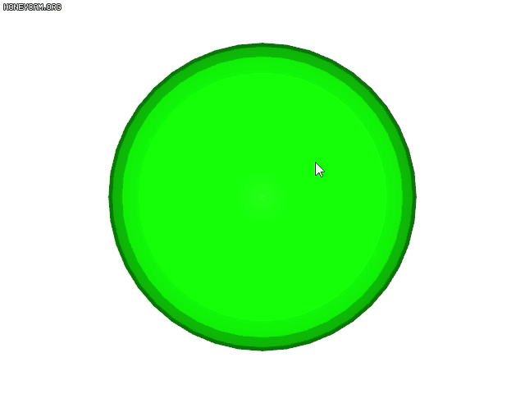
Chapter 4
C++ API
Open3D C++ API Bulid Using Cmake & MSVS 2019
Find Pre-Installed Open3D Package in Cmake
Test Code : Draw.cpp
https://github.com/isl-org/open3d-cmake-find-package

Slide 16
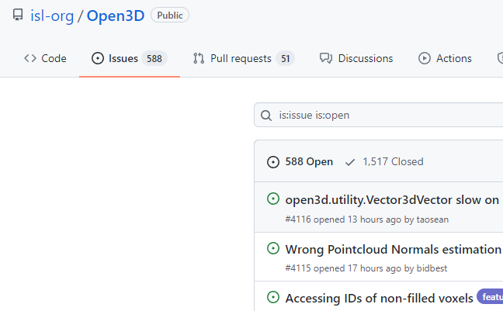
Chapter 5
Problem
문제점 및 보완점 problem & Solving

Slide 17
THANKS !
Thank you for watching !

